Slide 1
Simple 2D Environment
Brian Campana

Slide 2

Environment Details
Created a static 4 by 4 block of stations, along with a seed generator to create the days.
Home stations are the top corner stations, work stations are the bottom corner stations
Static walking cost – 5 for directly adjacent and 10 for diagonal
Params – 600 budget, 60 Bikes, 100 Max Customers
Seed 12 was used

Slide 3
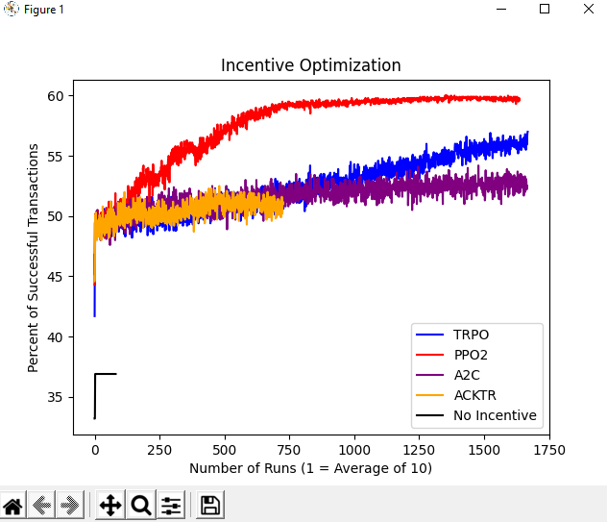
Rewards
PPO2 still did the best, however
TRPO could surpass it. Much lower
Overall success rate, never reaching
Over 60.

Slide 4
Stuff to implement
Figure out why learning.py always creates another seed
Dynamic environment/walking costs for stations
Find better parameters for the 2d implementation
Incentivizing arriving as well.

